Slide 1
基础数据结构(三) -- Heap
Lintcode 130. Heapify
Heap application: 1.HeapSort 2. PriorityQueue
你的好朋友Eddie

Slide 2
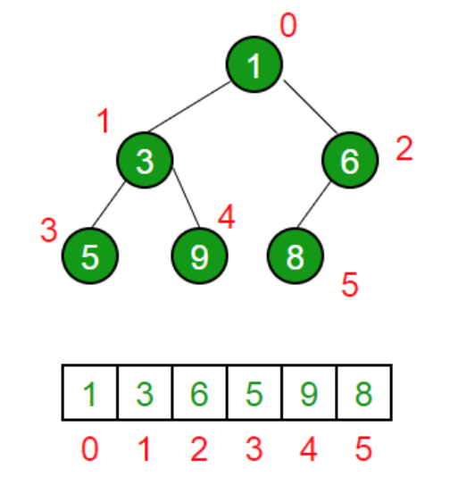
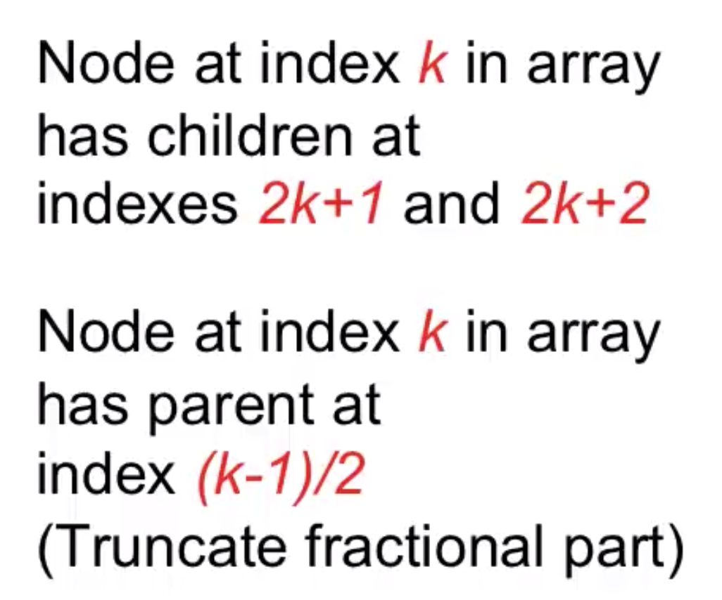
Heap Definition
(Binary) Heap is a special case of balanced binary tree data structure where the root-node key is compared with its children and arranged accordingly.
Min-Heap − Where the value of the root node is less than or equal to either of its children.
Max-Heap − Where the value of the root node is greater than or equal to either of its children.
This is important ->

Slide 3
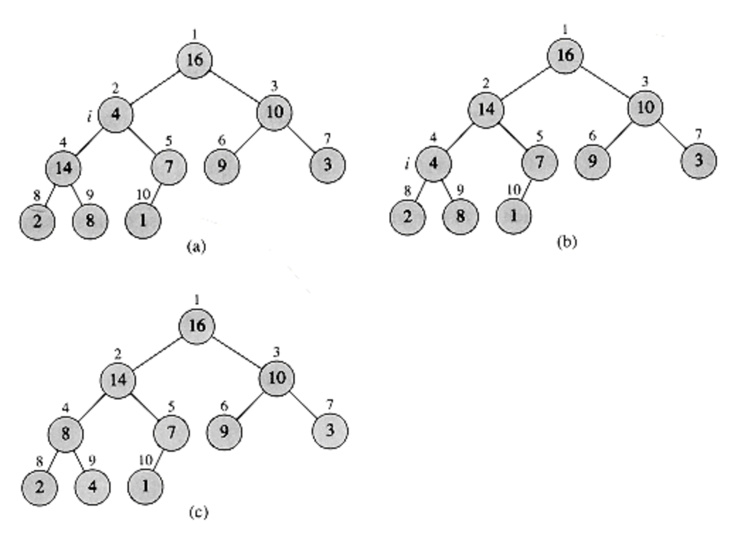
Heapify Definition
HEAPIFY is an important subroutine for manipulating heaps. Its inputs are an array A and an index i into the array. When HEAPIFY is called, it is assumed that the binary trees rooted at LEFT(i) and RIGHT(i) are heaps, but that A[i] may be smaller than its children, thus violating the heap property (7.1). The function of HEAPIFY is to let the value at A[i] "float down" in the heap so that the subtree rooted at index i becomes a heap.

Slide 4
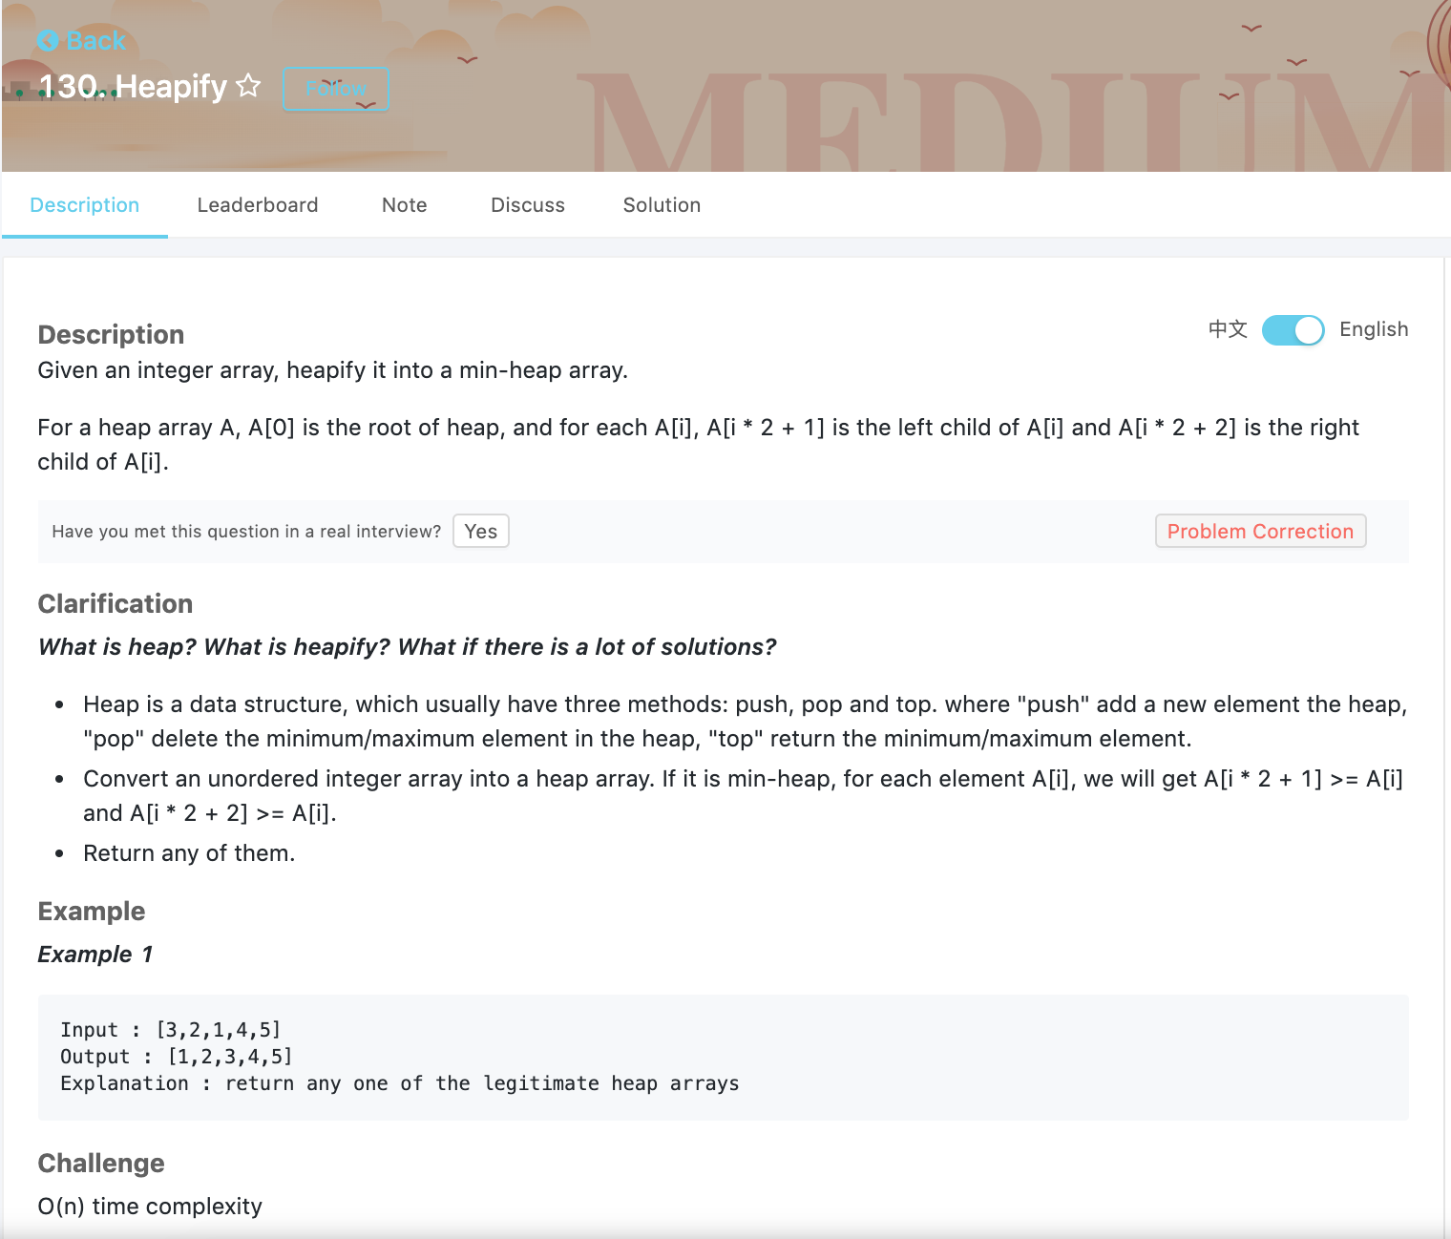

Slide 5
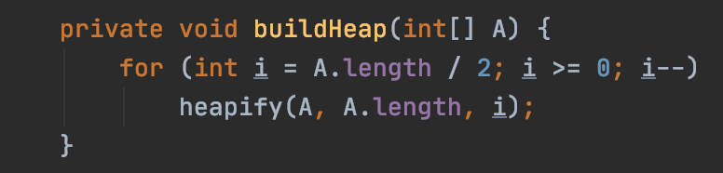
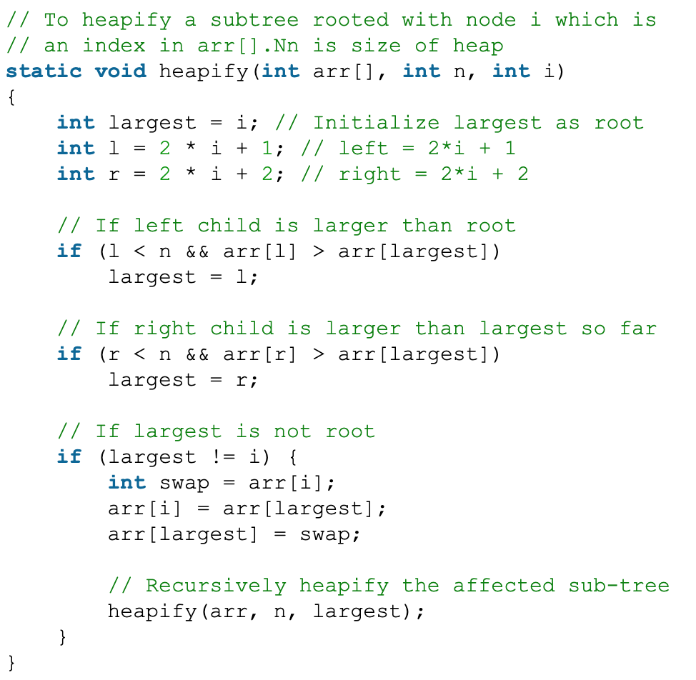
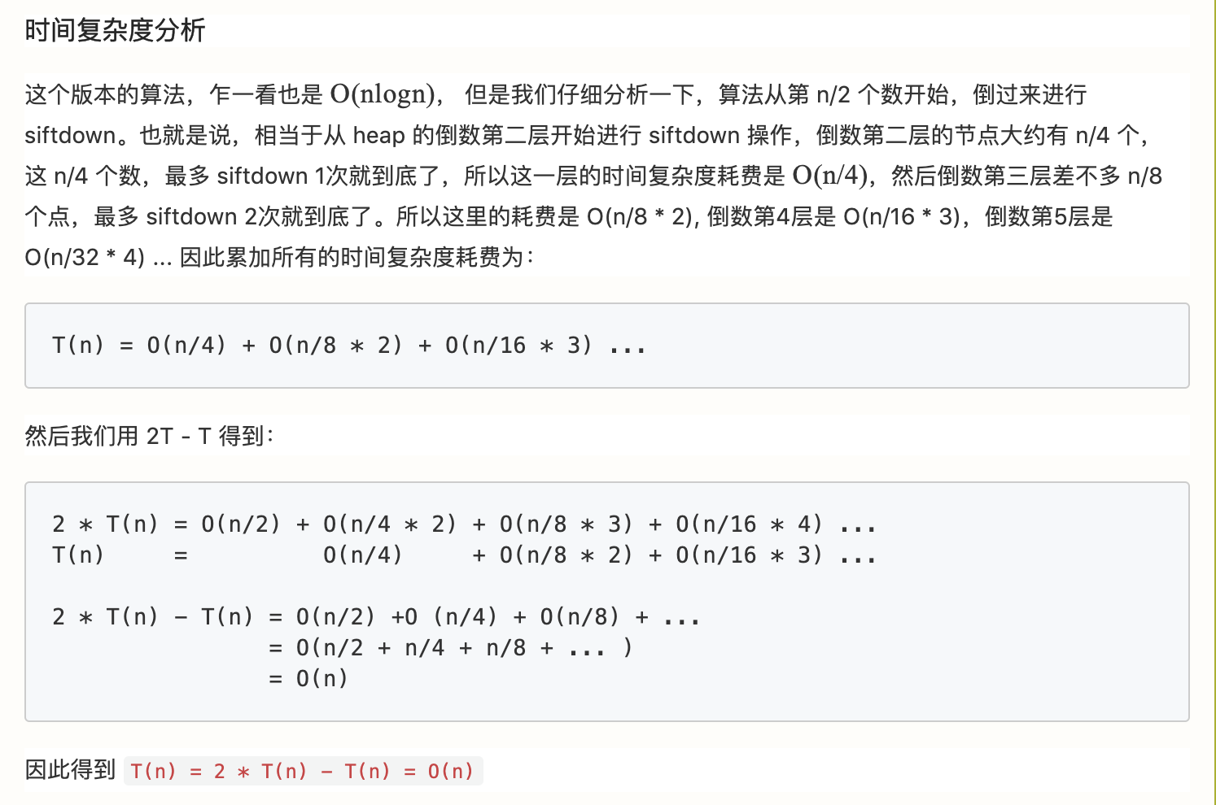
Heapify T(n) = O(n)

Slide 6
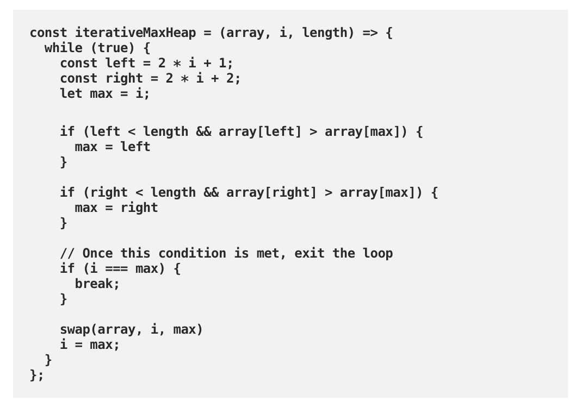
iterative

Slide 7
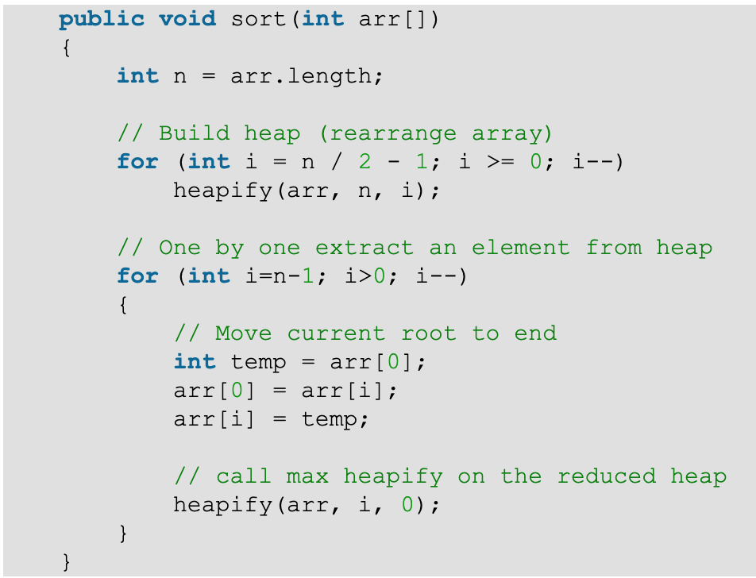
Let’s build an application using heap-- HeapSort
1. Build a max heap from the input data.
2. At this point, the largest item is stored at the root of the heap. Replace it with the last item of the heap followed by reducing the size of heap by 1. Finally, heapify the root of tree.
3. Repeat above steps while size of heap is greater than 1.

Slide 8
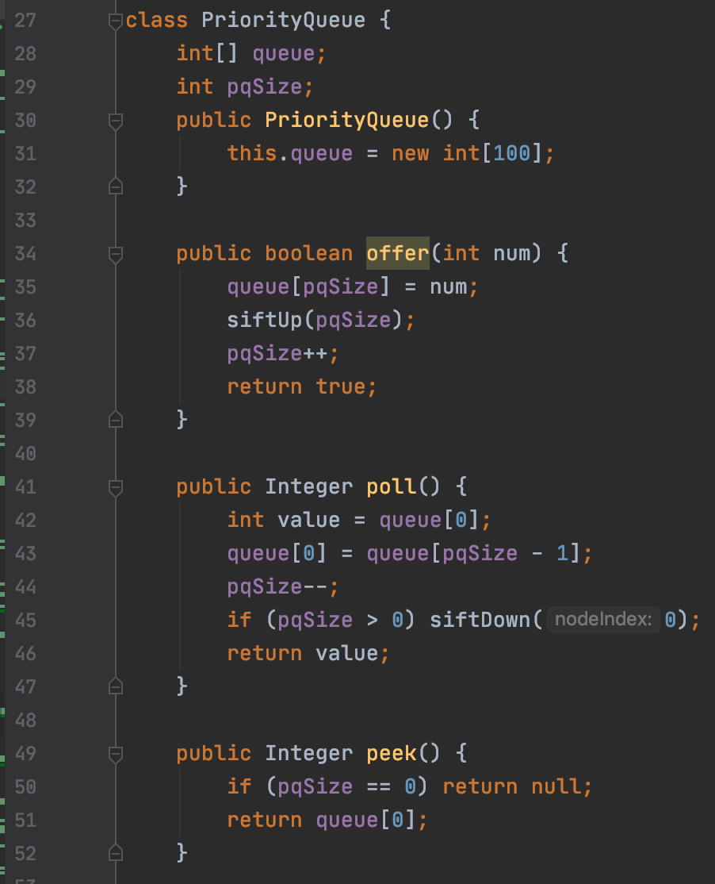
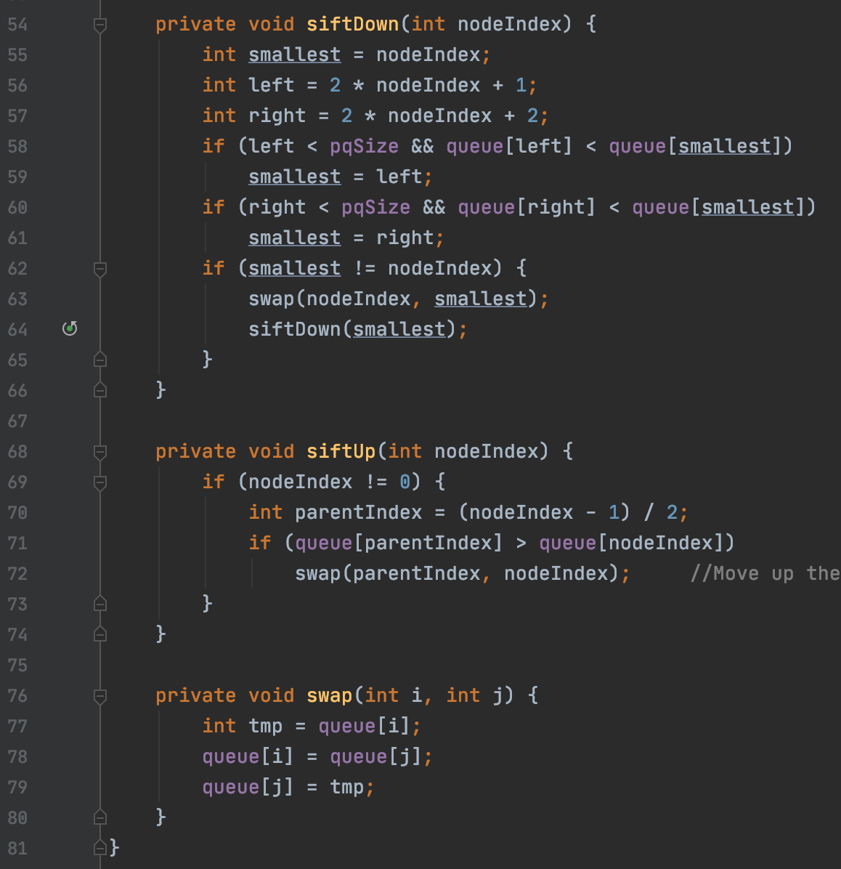
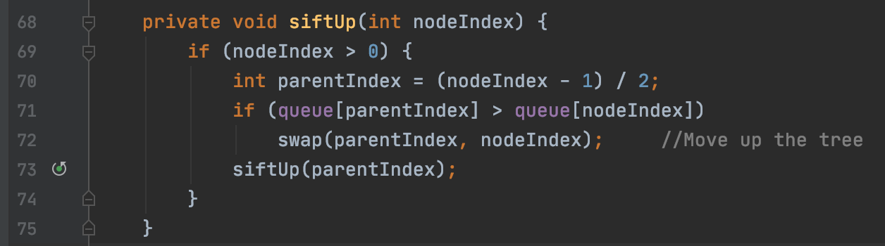
Let’s build an application using heap -- PriorityQueue
Method:
offer() : add number
pull() : get and remove the minimal number from pq
peek() : get the minimal number from pq

Slide 9
Heap Summary -- about time complexity
peekMax() or peekMin(), depends on which heap you implement, takes O(1)
add()/remove() a new number to heap would do logn times heapify, so time complexity is O(logn)
Delete random would cause O(n), because search O(n) + delete O(logn)
Build heap only takes O(n), we are doing heapify only for half of the element

